Slide 1

DESIGNING MONOLITH FIRST FOR MICROSERVICE ARCHITECTURE
Halil İbrahim Kalkan
halilibrahimkalkan.com
https://github.com/hikalkan/presentations

Slide 2

Agenda
About me & ABP Framework
Microservices and the monolith-first approach
Designing a modular monolith
The need for layering
Designing the database
Integrating the modules
Modularizing the UI
Migrating to microservices
Hosting & distribution
Replacing in-process service calls
Enabling transactional events
Handling database migrations
Authentication and authorization changes
Deployment

Slide 3
ABOUT ME & ABP FRAMEWORK
DESIGNING MONOLITH FIRST FOR MICROSERVICE ARCHITECTURE

Slide 4

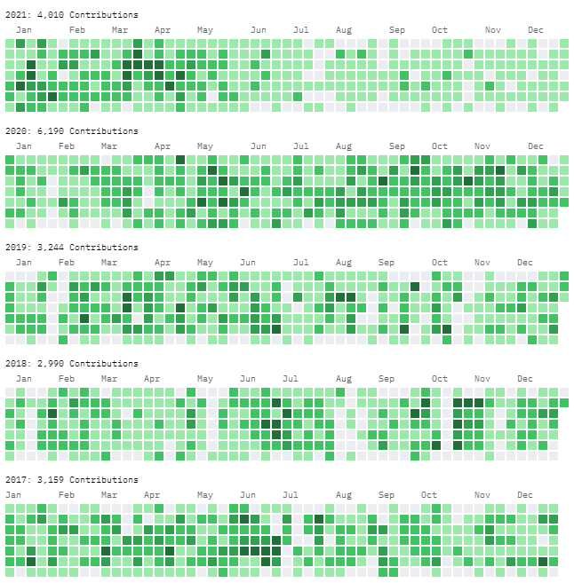
About me: Halil İbrahim Kalkan
halilibrahimkalkan.com
GitHub: hikalkan
Twitter: hibrahimkalkan

Slide 5
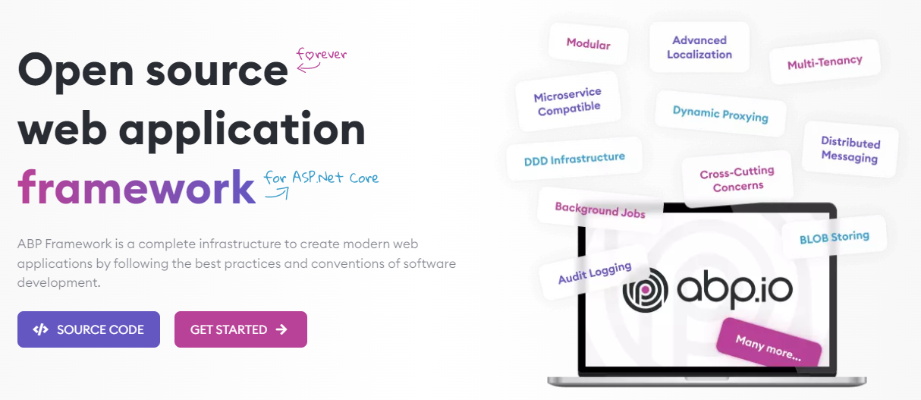
The ABP FRAMEWORK project https://abp.io --- https://github.com/abpframework

Slide 6
INTRODUCTION
DESIGNING MONOLITH FIRST FOR MICROSERVICE ARCHITECTURE

Slide 7
Microservice trade-offs
BENEFITS
Forcing the modularity and encapsulation
Independently developed, deployed and scaled
Technology diversity
COSTS
Distribution
Eventually consistency
Operational complexity

Slide 8


Microservices: Who is for?
Large development team with DevOps and automation culture
Large, complex and mature business or domain

Slide 9
Microservices: Who is (not) for?
My primary guideline would be don't even consider microservices unless you have a system that's too complex to manage as a monolith. The majority of software systems should be built as a single monolithic application. Do pay attention to good modularity within that monolith, but don't try to separate it into separate services.
--- Martin Fowler

Slide 10
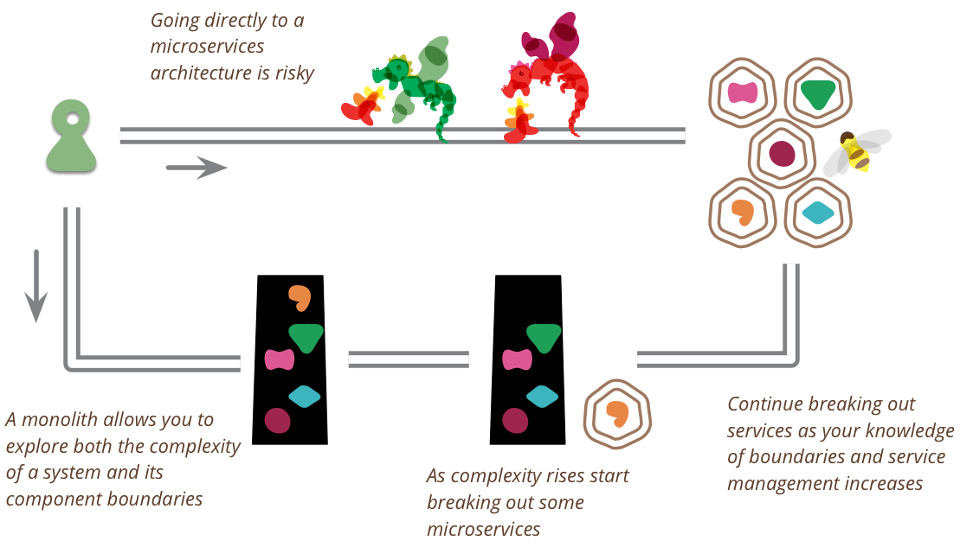
Monolith first: What?
You shouldn't start a new project with microservices, even if you're sure your application will be big enough to make it worthwhile.

Slide 11
Monolith first: Why?
YAGNI: Create a simplistic version first, maybe it won’t succeed.
Fast MVP, shorter time to market
Service boundaries & business requirements are not clear –refactoring a monolith is easier than a microservices
You’ve a small team

Slide 12
Monolith first: How?
Build as monolith (not modular), discard it and replace with microservices at some point
Build as monolith (may not be fully modular), introduce microservices by the time (keep the core as monolith for a while)
Create coarse-grained (large) services, then break down into finer-grained services as boundaries stabilize
Design a fully modular monolith, then migrate to microservices when it gets mature

Slide 13
Monolith first: When not?
You are already replacing a legacy monolith or distributed system!

Slide 14
DESIGNING A MODULAR MONOLITH
DESIGNING MONOLITH FIRST FOR MICROSERVICE ARCHITECTURE

Slide 15
The need for layering
DESIGNING A MODULAR MONOLITH

Slide 16
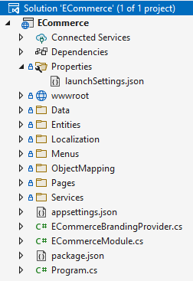
The need for layering Single-project solution
Data access logic
Business logic
Hosting logic
User interface

Slide 17


The need for layering Backend-frontend separation
Database
Data access logic
Business logic
Backend Application
Database
HTTP (REST) API
API Hosting logic
Data access logic
Business logic
API Gateway
User interface
Hosting logic
User interface
Frontend Application
UI Hosting logic
Browser / User
Browser / User

Slide 18
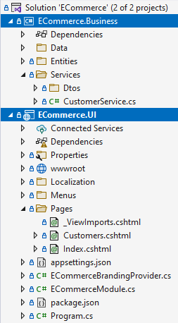
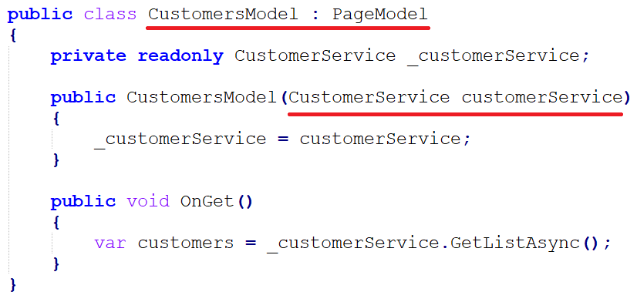
The need for layering Separating UI from business
ECommerce.UI --- (depends) ---> Ecommerce.Business

Slide 19
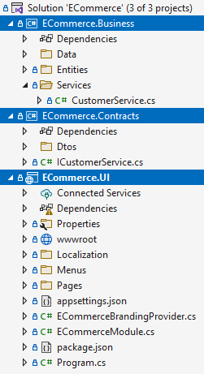
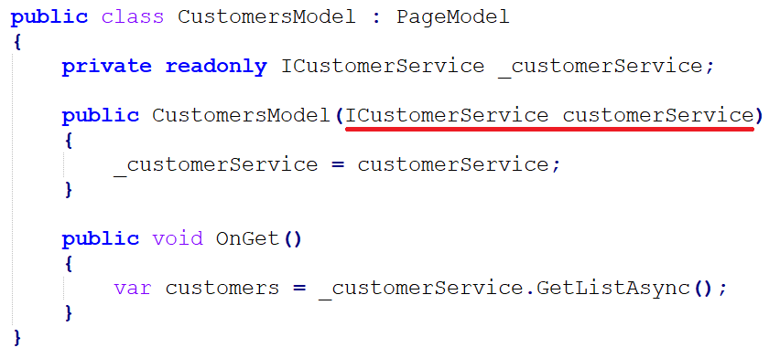
The need for layering Introducing business contracts
ECommerce.UI --- (depends) ---> ECommerce.Contracts
ECommerce.Business --- (depends) ---> ECommerce.Contracts

Slide 20
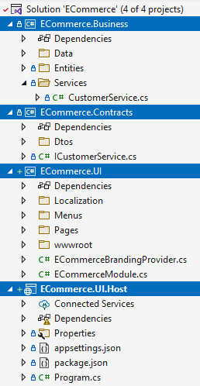
The need for layering Separating the hosting project
ECommerce.UI --- (depends) ---> ECommerce.Contracts
ECommerce.Business --- (depends) ---> ECommerce.Contracts
ECommerce.UI.Host --- (depends) ---> ECommerce.UI
ECommerce.Business

Slide 21

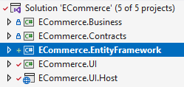
The need for layering Separating the data access project

Slide 22
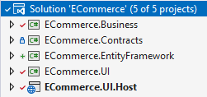
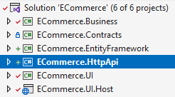
The need for layering Adding HTTP (REST) APIs

Slide 23
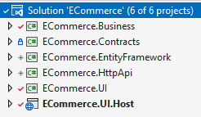
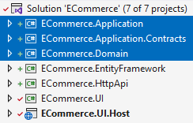
The need for layering Implementing layering for Domain-Driven Design

Slide 24
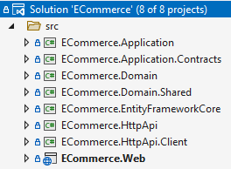
The need for layering ABP’s layered module solution structure
Domain.Shared
Domain
EF Core
Application.Contracts
Application
HttpApi.Client
HttpApi
Web

Slide 25
The need for layering Hosting as a monolith
Domain.Shared
Domain
EF Core
Application.Contracts
Application
HttpApi.Client
HttpApi
Monolith Hosting
Application
Web

Slide 26
The need for layering Hosting in different applications
Background Service Application
Domain.Shared
Domain
EF Core
Client Application
Application.Contracts
Application
HttpApi.Client
HttpApi
Service Hosting Application
UI Hosting Application
Web
HTTP API calls

Slide 27
The need for layering Hosting a modular monolith
Customer module
Order module
Payment module
Basket module
Monolith Host Application

Slide 28
Designing the database
DESIGNING A MODULAR MONOLITH

Slide 29
Designing the database Single (shared) database approach
+ Easy to develop, test, deploy and maintain
- All modules should use the same database technology
- Should care about the data isolation between modules
Database
Customer module
Order module
Payment module
Basket module
Monolith Host Application

Slide 30
Designing the database Single (shared) database approach
Restrict access for each module with different connection strings, so modules can’t use other modules’ data (separate schemas)
Separate DbContext classes for Entity Framework Core
Unify EF Core database migrations
Database
Customer module
Order module
Payment module
Basket module
Monolith Host Application

Slide 31
Designing the database Separate (multiple) database approach
- Harder to develop, test, deploy and maintain
+ Every module may use the best database technology for its purpose
+ You don’t care about the data isolation between modules
HYBRID: Separate database whenever you need a different database technology for a module
Customer module
Order module
Payment module
Basket module
Monolith Host Application

Slide 32
Designing the database Module specific DbContext classes

Slide 33
Designing the database Unified DbContext for database migrations

Slide 34
Designing the database Database connection string management
TODO:
DbContext selection
Connection string selection
Managing database connections and transactions

Slide 35
Designing the database Common principles
Do not access to other modules’ database
Do not perform JOIN queries across different modules
Denormalize/duplicate data when needed
Asynchronously update the duplicated data if necessary
Create reporting module(s) with its own tables/databases – feed them using distributed events
ABP provides auto distributed events for all entities

Slide 36
Integrating the modules
DESIGNING A MODULAR MONOLITH

Slide 37
Integrating the modules Common principles
A module should not touch other module’s internal APIs and database
Should talk with public integration APIs (synchronous communication) and distributed events (asynchronous communication)

Slide 38
Integrating the modules Synchronous communication
Create integration services (internal application services)
Best for;
Read (query) operations
Repeatable (idempotent) write (update/delete) operations
Don’t assume database transaction for inter-module operations
Use caching for read operations (especially for critical performance paths)
Use data duplication (and synchronization) to perform local database table JOINs
Monolith Host (single process)
Order module
Customer module
Query customer

Slide 39
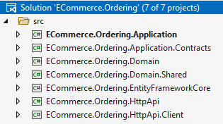
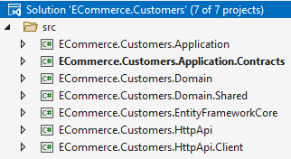
Integrating the modules Synchronous communication: project dependencies
Reference to Customers.Application.Contracts (or Customers.Integration.Contracts) project
Monolith hosting application brings the implementations together
Microservice hosting application uses the Customers.HttpApi.Client project

Slide 40
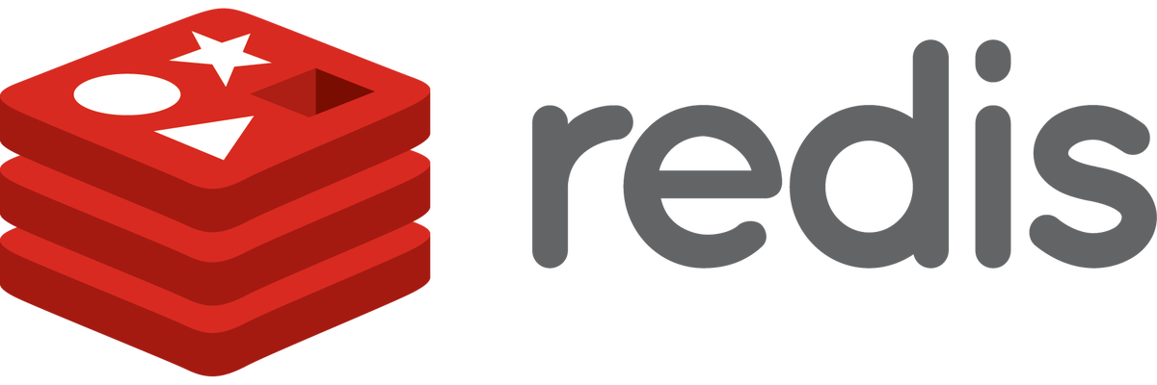
Integrating the modules Synchronous communication: caching
Monolith Host (single process)
Order module
Customer module
Query customer
Distributed cache
Not found in the cache
Invalidate the cache
Found in the cache

Slide 41
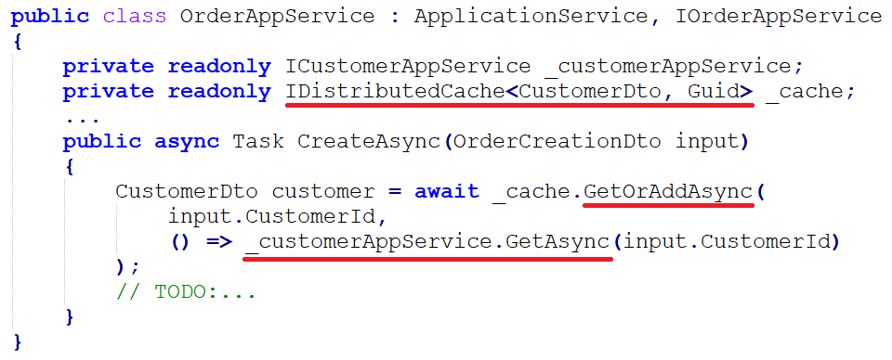
Integrating the modules Synchronous communication: caching

Slide 42
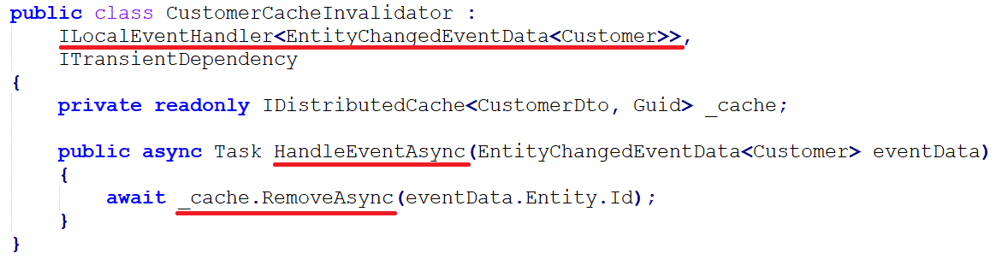
Integrating the modules Synchronous communication: caching

Slide 43

Integrating the modules Synchronous communication: data duplication
(4)
(1) Query local database
(2) Use local data
(4) Update local data
(7)
(2)
(1)
(7) Update local data
Monolith Host (single process)
Order module
Customer module
(3) Query customer (potentially use cache)
Distributed Event Bus
(6) Change event
(5) Change event

Slide 44
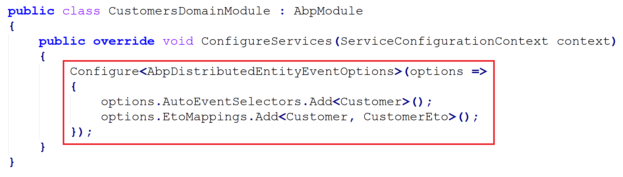
Integrating the modules Synchronous communication: data duplication

Slide 45
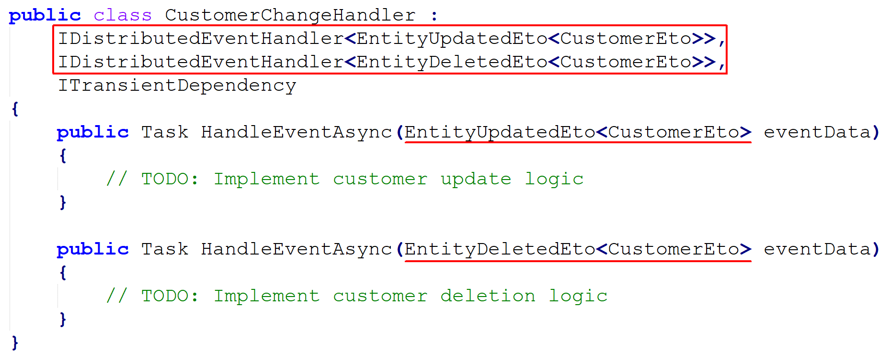
Integrating the modules Synchronous communication: data duplication

Slide 46
Integrating the modules caching vs data duplication
Caching
+ Faster & lightweight
+ Doesn’t need synchronization
- Only individual access to the cached data
- Limited offline access
Use if you only need to query individual data
Data duplication
- Slower (database operations)
- Needs synchronization
+ Individual and mass access (JOIN queries) to the duplicated data
+ Better offline access
Use if you need to query mass data
YOU CAN ALWAYS COMBINE TOGETHER

Slide 47

Integrating the modules Asynchronous communication
Monolith Host (single process)
Microservice Host
Distributed
Event Bus
Microservice Host
Order module
Distributed
Event Bus (in-process)
Customer module
migrating to
microservices
Order service
Customer service

Slide 48
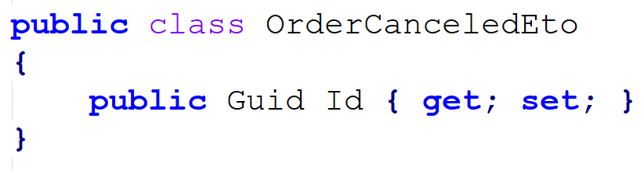
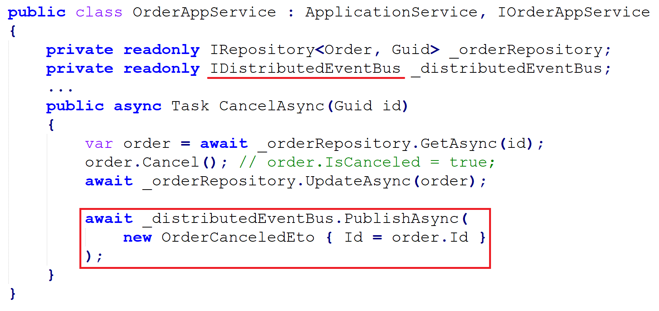
Integrating the modules ABP’s distributed event bus

Slide 49
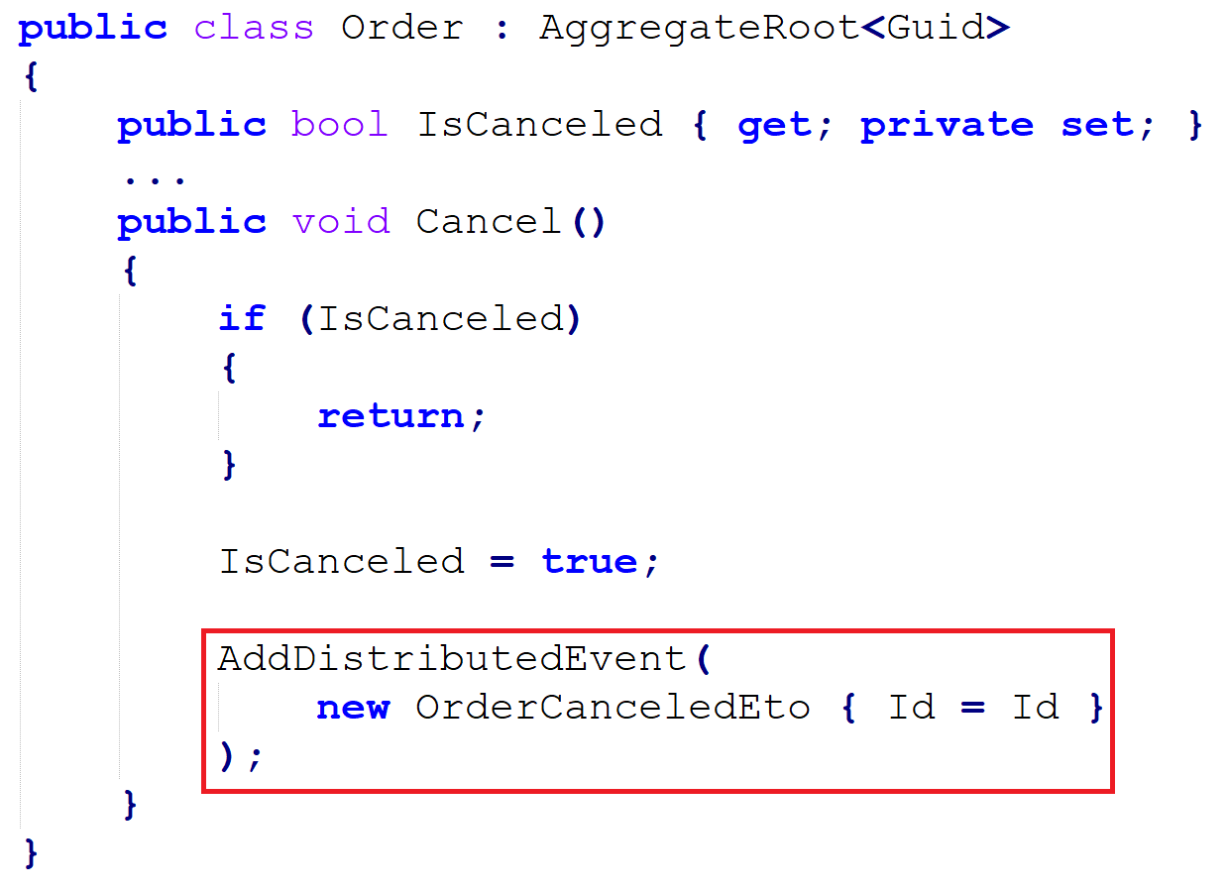
Integrating the modules ABP’s distributed event bus

Slide 50
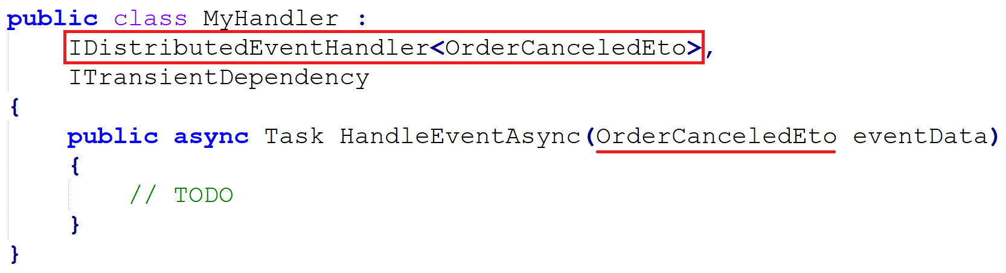
Integrating the modules ABP’s distributed event bus

Slide 51
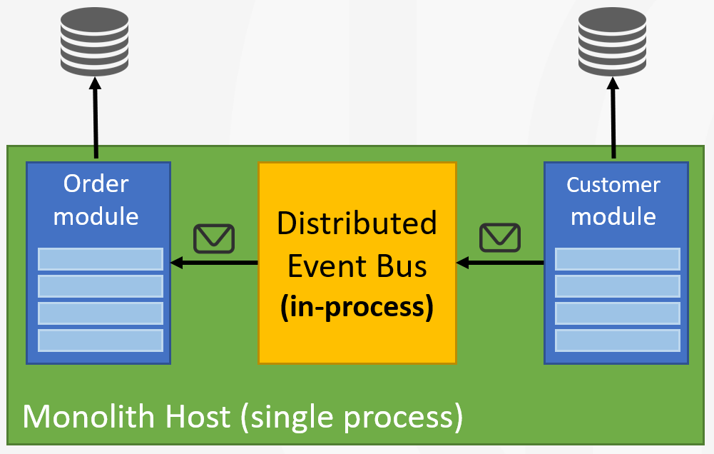
Integrating the modules Transaction & exception handling behavior
Execute the handlers in the same database transaction (unit of work)
Execute the handlers just before committing the transaction

Slide 52
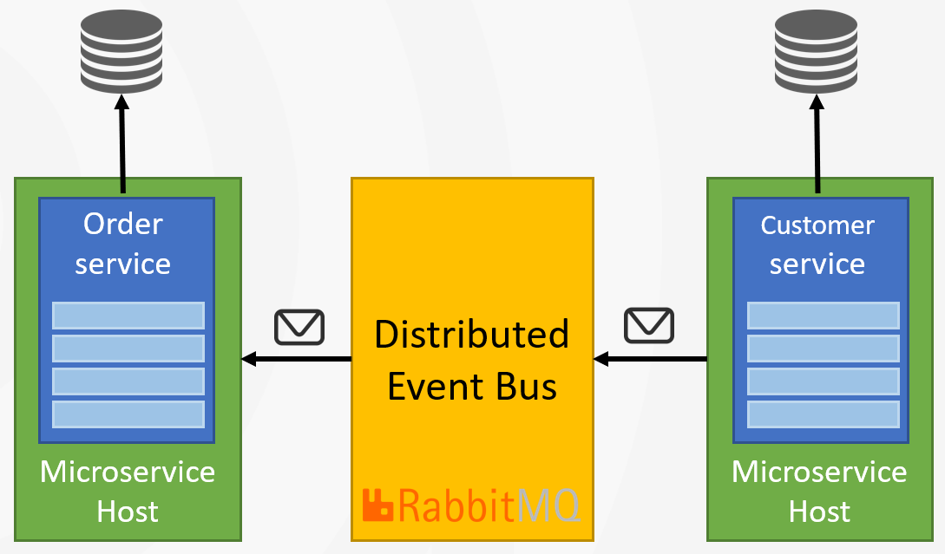
Integrating the modules Transaction & exception handling behavior
Use the outbox pattern to ensure transactional event publishing
Use the inbox pattern to ensure an event is processed only once
Use distributed locking to handle concurrency

Slide 53

Integrating the modules Transaction & exception handling behavior
Microservice A
Microservice B
event
event
ABP Event Bus
Message Broker
(RabbitMQ, Kafka, etc)
ABP Event Bus
application data
application data
re-connect
re-try
publish/subscribe
background workers
auto-events
distributed locking
outbox/inbox
outbox/inbox

Slide 54
Modularizing the UI
DESIGNING A MODULAR MONOLITH

Slide 55
Modularizing the UI Monolith UI layer
Customer service
Order service
Payment service
Basket service
Monolith host (single process)
Customer module
Order module
Payment module
Basket module
migrating to
microservices
User Interface Layer
API Gateway (backend for frontend)
User Interface Application

Slide 56
Modularizing the UI Modular UI layer
Customer service
Order service
Payment service
Basket service
Monolith host (single process)
Customer module
Order module
Payment module
Basket module
migrating to
microservices
API Gateway (backend for frontend)
User Interface Layer
User Interface Layer
UI Module 1
UI Module 2
UI Module 3
UI Module 1
UI Module 2
UI Module 3
UI Module 4
UI Module 4
UI Aggregation Layer
UI Aggregator Layer

Slide 57
Modularizing the UI Monolith UI vs Modular UI
Monolith UI
Easier to develop
Good for integrated applications
Modular UI
Much harder to develop
Good for independent modules
Not for scalability, fault tolerance or technology freedom! Use micro frontends approach for these.

Slide 58
MIGRATING TO MICROSERVICES
DESIGNING MONOLITH FIRST FOR MICROSERVICE ARCHITECTURE

Slide 59
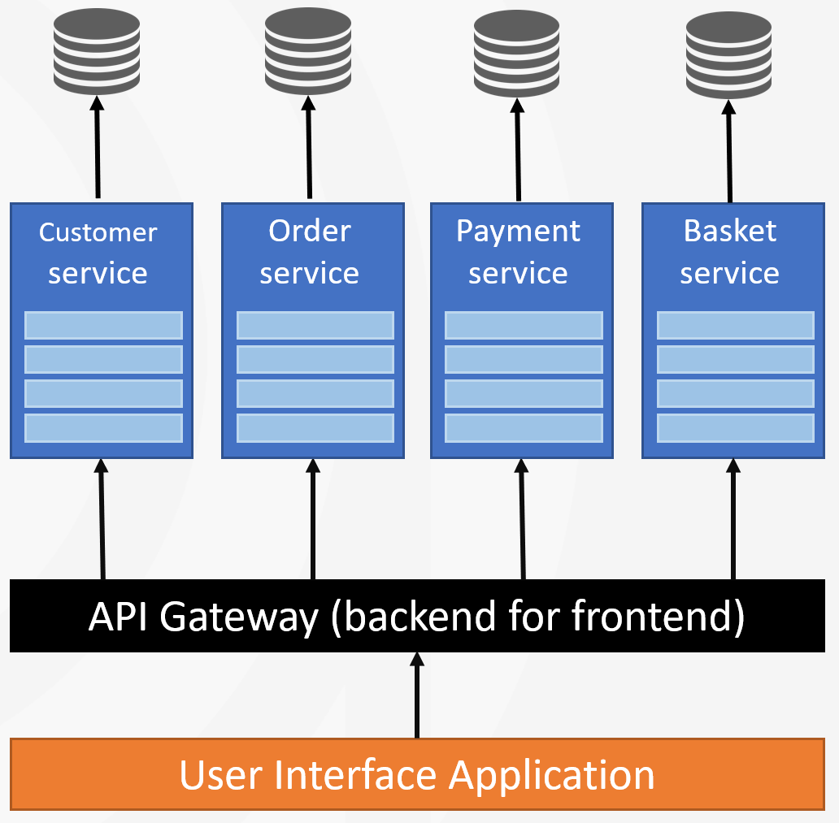
Migrating to microservices Hosting
Create a microservice host application for each module (or group modules into microservices)
Create an API gateway application (or use an external service)
Create a UI hosting application that consumes the API gateway
Configure the authentication

Slide 60
Migrating to microservices Distribution
Switch to distributed caching Volo.Abp.Caching.StackExchangeRedis
Switch to distributed messaging Volo.Abp.EventBus.RabbitMQ

Slide 61
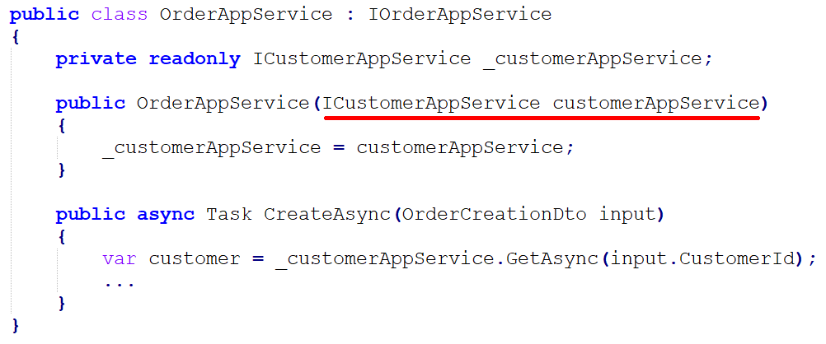
Migrating to microservices Replacing in-process service calls: abstracting

Slide 62
Migrating to microservices Replacing in-process service calls: client proxies
ICustomerAppService (in ECommerce.Customers.Application.Contracts)
CustomerAppService (in ECommerce.Customers.Application)
CustomerAppServiceHttpClientProxy (in ECommerce.Customers.HttpApi.Client)
Auto-generated by the ABP Framework (by handling errors, retry, authentication, JSON serialization, endpoint discovery, etc.)

Slide 63
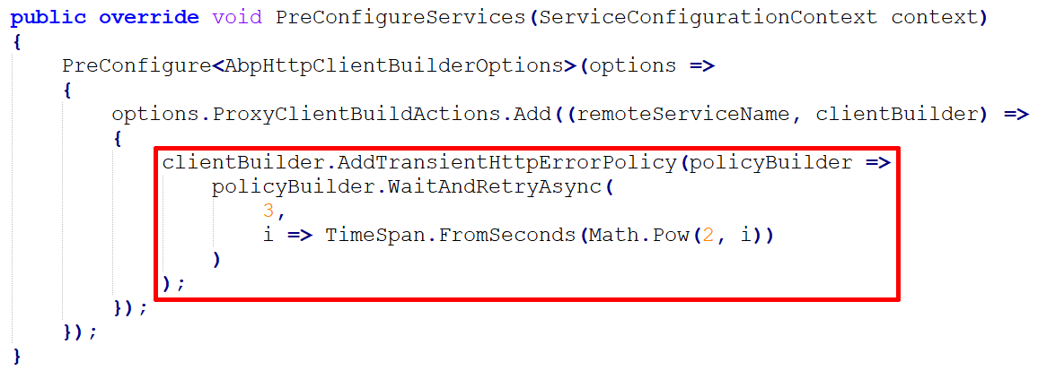
Migrating to microservices Replacing in-process service calls: retry policies

Slide 64
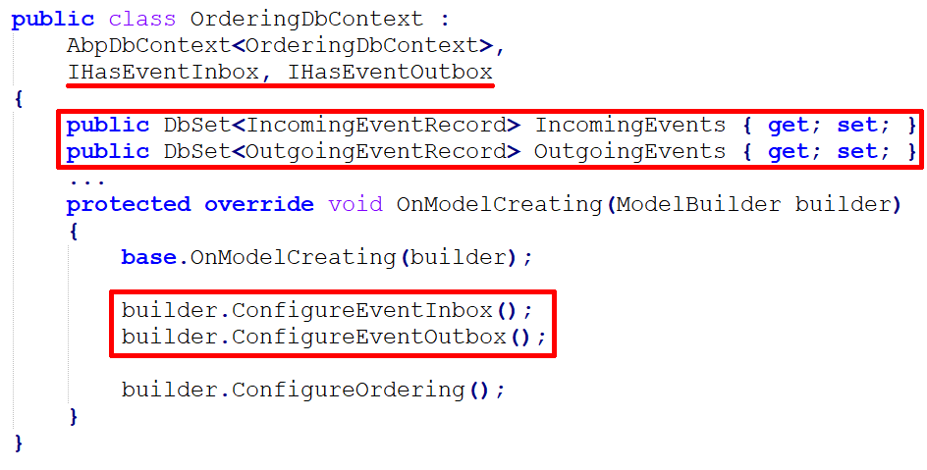
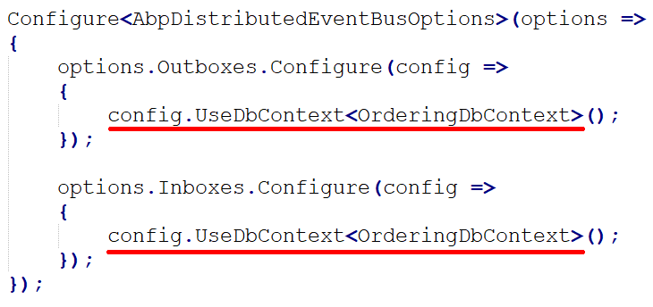
Migrating to microservices Enabling outbox & inbox for transactional events

Slide 65
Migrating to microservices Handling database migrations: monolith
The main DbContext unifies the database migration path
Every module has its own data seeder & ABP executes all of them
A separate DbMigrator console application
Customer module
Order module
Payment module
Basket module
Monolith Host Application

Slide 66
Migrating to microservices Handling database migrations: microservices
Every service migrates its own database on startup & seeds its own data
Uses distributed locking for concurrency control
Multi-Tenancy with separate databases: Publish event, handle in services, create the tenant database

Slide 67

Migrating to microservices Authentication & authorization: monolith
login
Monolith Host Application
User Interface / API
Customer module
customer database
authentication cookie
inter-module
API calls
Browser
HTTP request
cookie with claims
Order module
order
database
permission/policy
database

Slide 68
Migrating to microservices Authentication & authorization: microservices
login
Authentication server
authentication cookie
User Interface / API
API Gateway
Customer service
customer database
HTTP Request
HTTP header
with claims
inter-service
API calls
HTTP Request
HTTP header
with claims
Browser
HTTP request
cookie with claims
Order service
order
database
permission/policy
database

Slide 69
Migrating to microservices authorization: microservices
Should we authorize inter-microservice API calls?
YES: Forward HTTP authorization header (token) to other service (ABP automates by default)
YES: Re-authenticate with client-credentials flow (ABP automates when you configure)
NO: Use non-authorized integration APIs

Slide 70
Migrating to microservices Development environment
Run all the services, databases, API gateways, etc.
Useful tools
Tye project
Docker / docker-compose
Custom scripts

Slide 71
Migrating to microservices Deployment
Setup a continuous deployment pipeline
Tools: Jenkins, Azure DevOps, etc.
Use a container orchestration tool
Tools: Kubernetes with Helm configuration
Configure a central logging system
Tools: Elasticsearch with Kibana UI
Setup a monitoring system
Tools: Prometheus with Grafana UI

Slide 72
References / further reading
ABP
https://abp.io
https://docs.abp.io
https://community.abp.io
Martin Fowler’s website
https://martinfowler.com
https://martinfowler.com/articles/microservice-trade-offs.html
https://martinfowler.com/bliki/MicroservicePremium.html

Slide 73
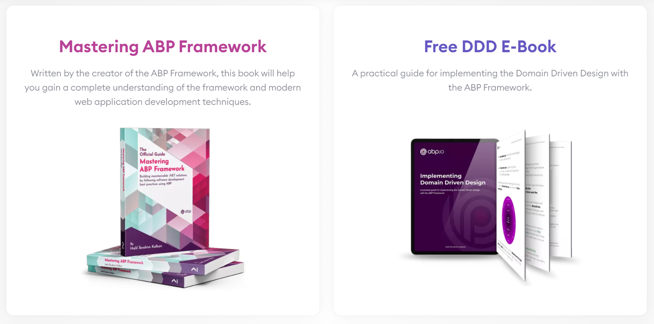
THANKS!
DESIGNING MONOLITH FIRST FOR MICROSERVICE ARCHITECTURE
https://github.com/hikalkan/presentations

